Slide 1
Midyear Presentation (Jan-June 2025) By: Ali Simon Jarana

Slide 2
Presentation Outline
Monitoring Programs and Observations
Regulatory Impacts & Interventions
Conclusion and Way forward
2
4
1
3
5
6
Complaint Management
Public Education
Special Initiatives

Slide 3
Complaint Management
The Northern Regional Office for the period under review received complaints against NEDCo, GWL and Consumers as indicated below;

Slide 4
Complaint Management
The Northern Regional Office for the period under review received complaints from the underlisted channels with the most used source been the electronic media
Channels of Complaints
Electronic | Walk In | Phone In | Written | Field | Total
325 | 23 | 245 | 21 | 2 | 616
53% | 4% | 40% | 3% | 0.32% | 100%

Slide 5
Complaint Management
For the period under review the office received these categories of complaints were lodged against NEDCo, GWL and Consumers

Slide 6
Complaint Management

Slide 7
Monitoring Programs and Key Observations
The Northern Regional Office for the period under review embarked on:
Customer Service Center Monitoring
Community Monitoring
Third Party Vending Station and Community Monitoring
Industrial Monitoring
Public Education and Complaint Clinic

Slide 8
Monitoring Programs
No. | Activity/Program | Utility | Districts/Communities
1. | Customer Service Center Monitoring | NEDCo | Nyankpala, Kumbungu, Savelugu, Karaga, Yendi, Tamale North, Tamale South, Tamale East and Tamale West(9)
 |  | GWL | Yendi, Dalun, Tamale East, Tamale North-East, Tamale West, and Tamale South-West Districts(6)
2. | Customer Service Center Monitoring | NEDCo | Chinderi, Kpandai, Bimbilla, Damongo and Buipe. (5)
3. | Community Monitoring | NEDCo | Zabzugu, Tatale, Mion, Yendi and Gushegu Districts.(5)
4. | 3rd Party Vending station and Community Monitoring | NEDCo | Tamale, Kumbungu and Nanton

Slide 9
Monitoring Programs
No. | Activity/Program | Utility | Districts/Communities
5. | Industrial Monitoring | NEDCo & GWL | Tamale North & North East

Slide 10
Key Observations
No. | Activity/Program | Utility | Observations
1. | Customer Service Center Monitoring | NEDCo | Confined space for office operations, some stations are not accessible to physically challenge customers, faded or no signages for outstation, poor security for bonded cashiers at some outstations, no impress for office operations, delayed NSC due to short supply of meters and the non-functionality of the eGIS
 |  |  | Short supply of prepaid cards, staffing and vehicular challenges
 |  | GWL | Poor outlook, poor staffing especially customer care assistants and short supply of meters and materials for connection resulting in thousands of customers placed on estimates.

Slide 11
Key Observations
No. | Activity/Program | Utility | Observations
2. | Community Monitoring | NEDCo | Persistent phase offs, outages and voltage fluctuations especially during the heat season. Inconsistent meter reading and bill delivery(accumulated billing). Removal of service wires during disconnections to be replaced by customers. Payment for bills not reflecting resulting in unlawful disconnections. Poor response time for faults
 |  |  | Fading receipts from NEDCo making reconciliation difficult during revenue mobilization exercises. Improved awareness of the commission in the visited comm
 |  |  | Lack of education regarding billing, metering and disconnection procedures as well as poor publicity of NEDCo’s fault contacts

Slide 12
Key Observations
No. | Activity/Program | Utility | Observations
3. | Third Party Vending station Monitoring | NEDCo | Short supply of POS devices for vending operations for damaged ones. Vending platforms allowing some purchased credit to be save to customers account that allows vendors to vend from such accounts.
 |  |  | Inconveniences associated with purchased power not reflecting on the meters of customers due to network challenges
 |  |  | Poor awareness of tariff adjustment and its implications on purchased credit
 |  |  | Improved awareness of the Commission and its operations

Slide 13
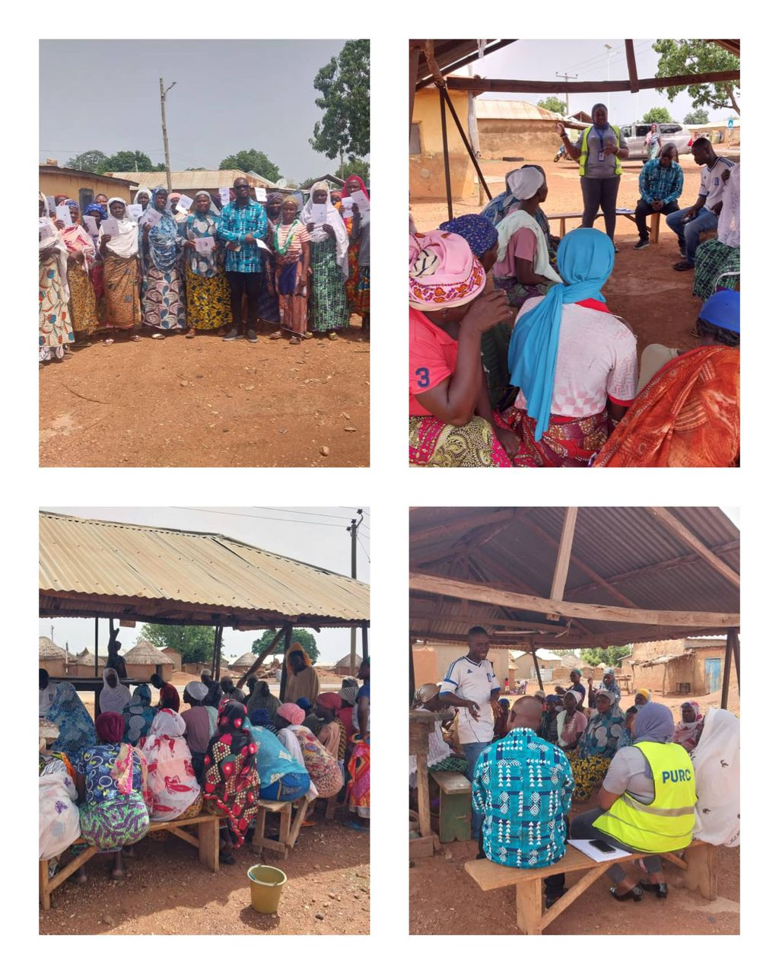
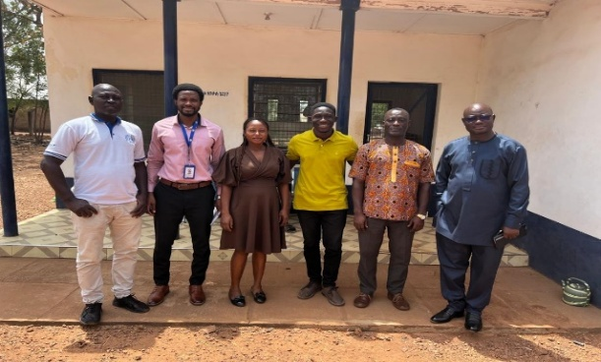
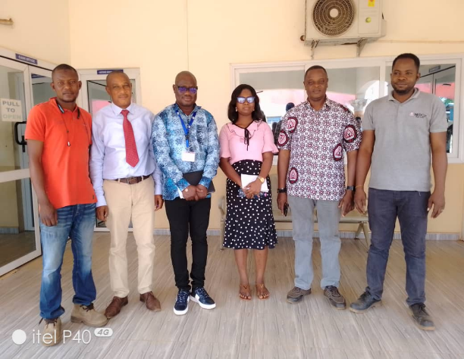
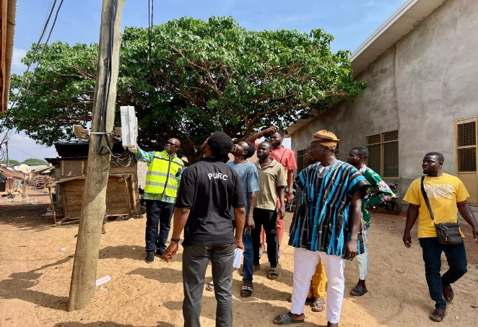
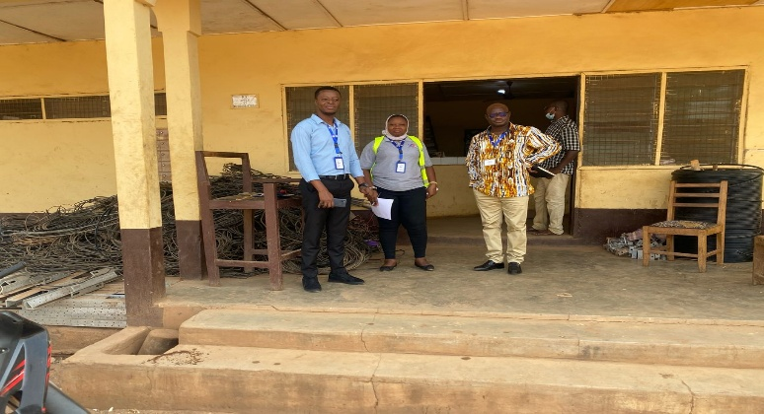
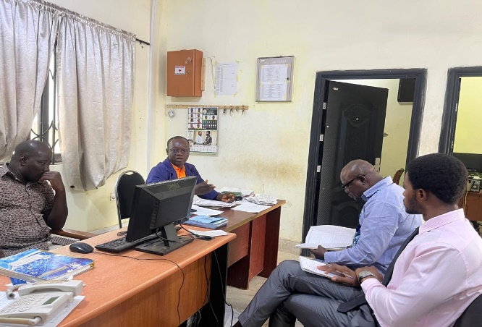
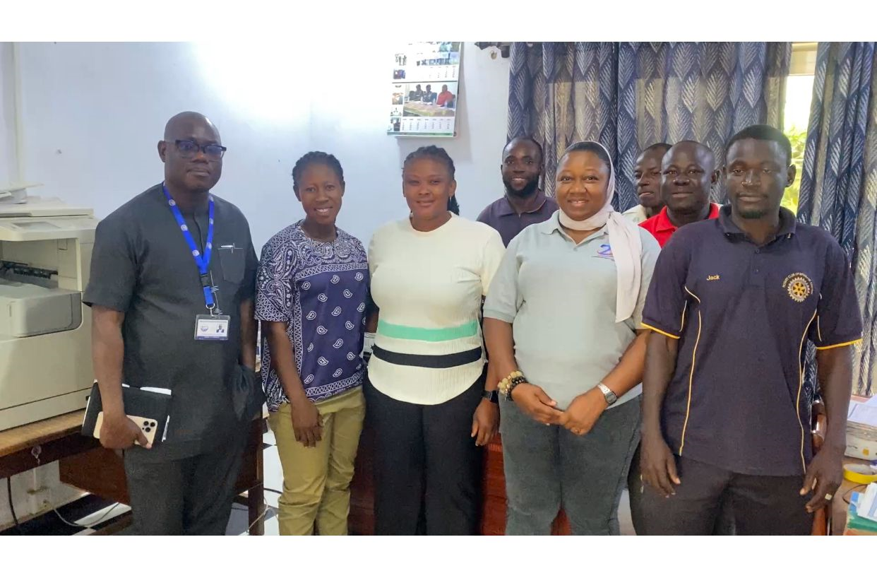
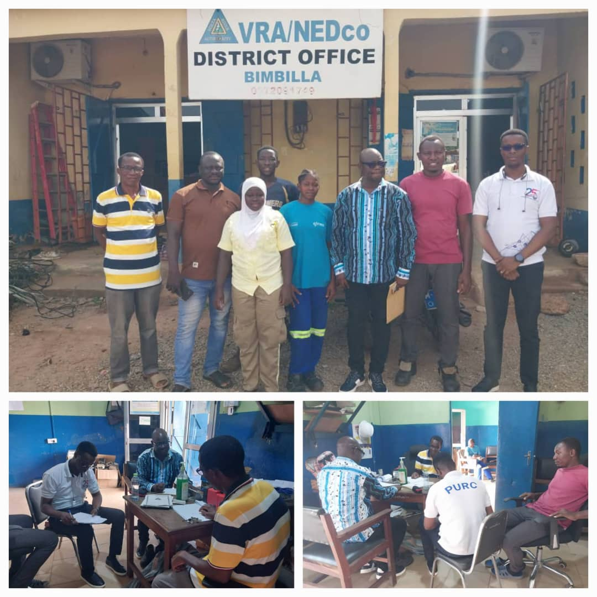
Monitoring Programs(Outstation and Community Monitoring)

Slide 14
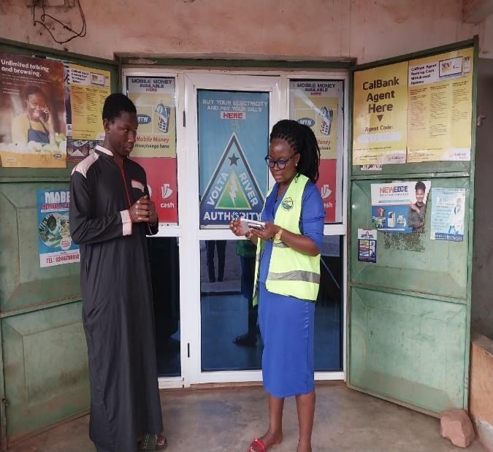
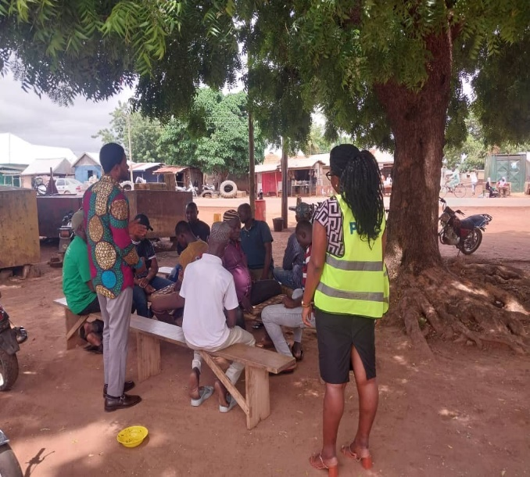
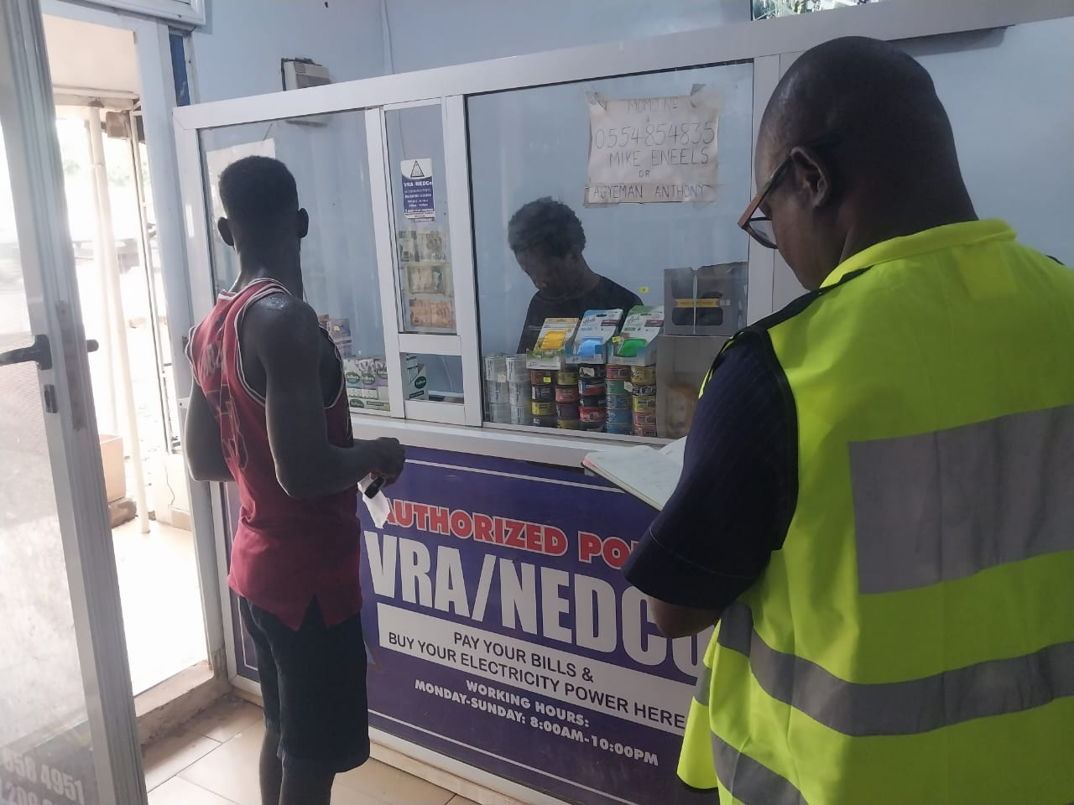
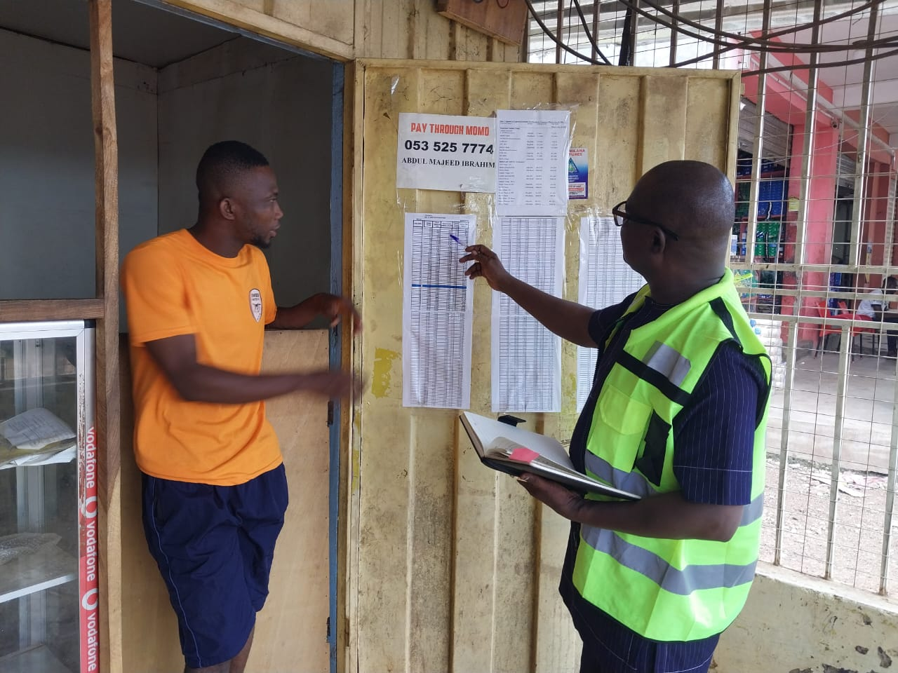
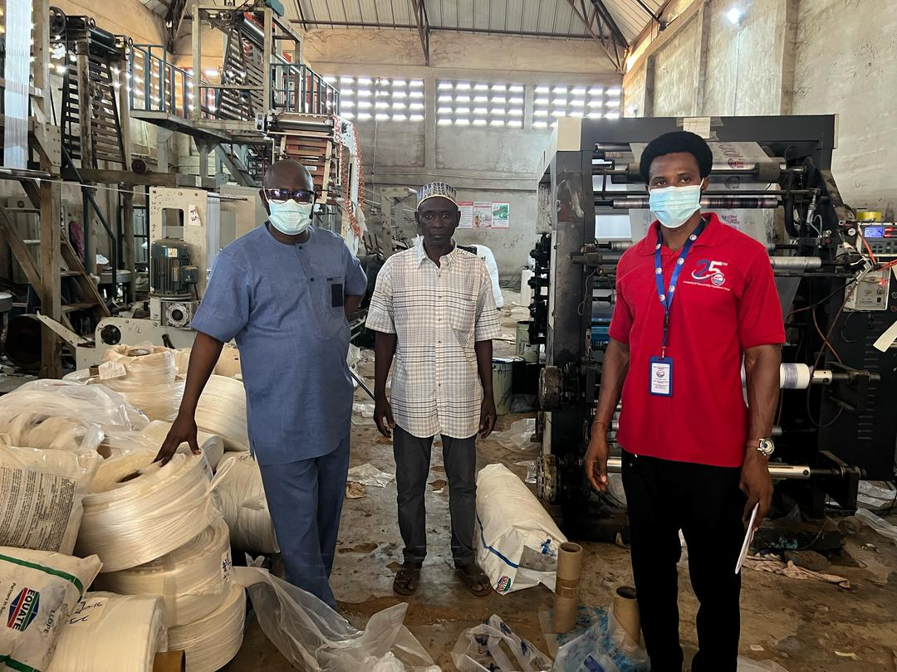
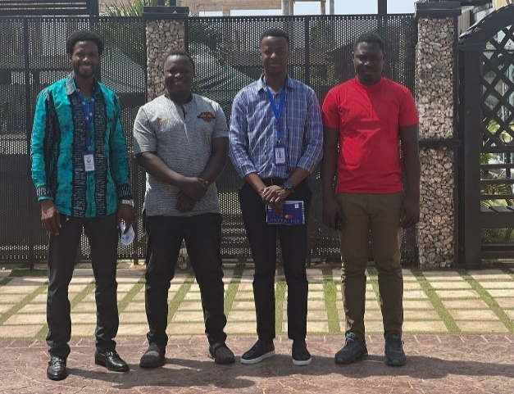
Monitoring Programs(Industrial and 3rd Party Vending Station Monitoring)

Slide 15
Public Education (Planned and Unplanned)
No. | Categories | Engagement | Attendance/ Participants
1. | Communities | 19 | 722
2. | Media(Radio & Tv) | 7 | -
5. | Associations | 1 | 76
6. | Educational Institutions | 4 | 4,200
7. | Religious Bodies | 5 | 365
8. | Total | 49 | 5,363

Slide 16
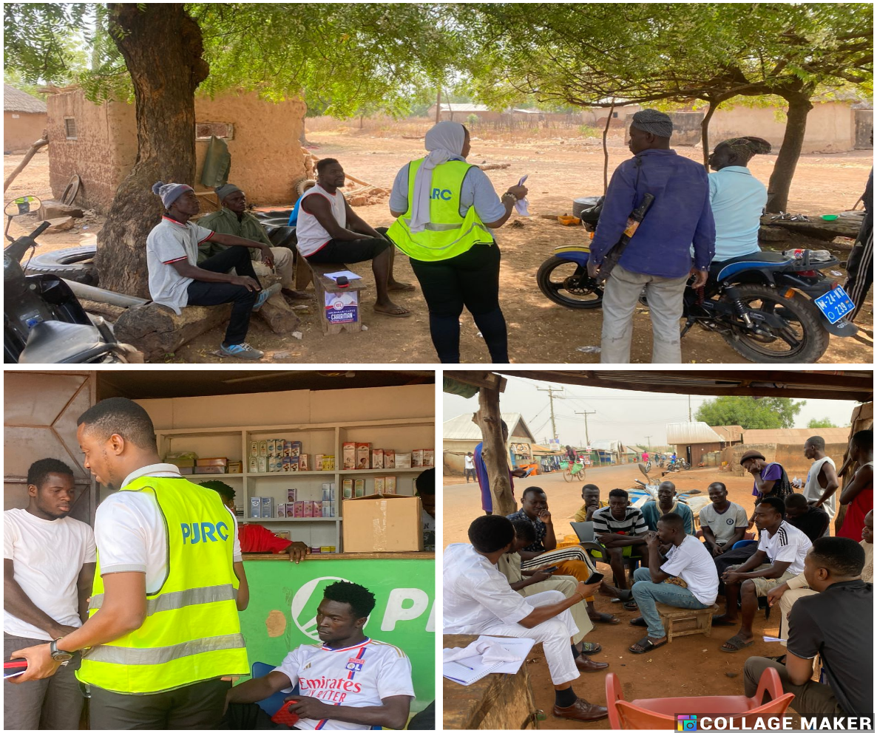
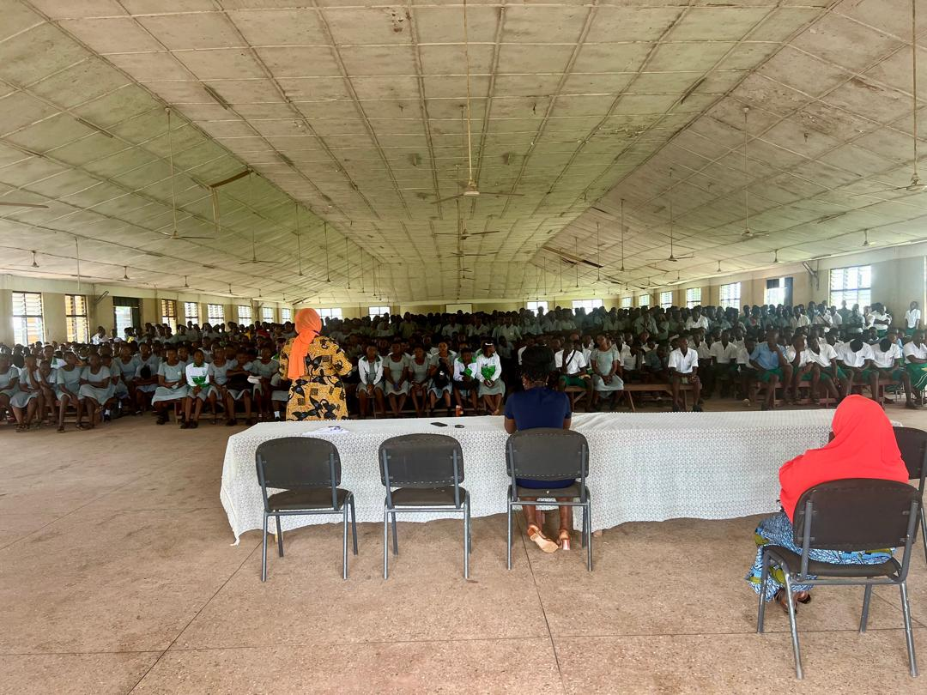
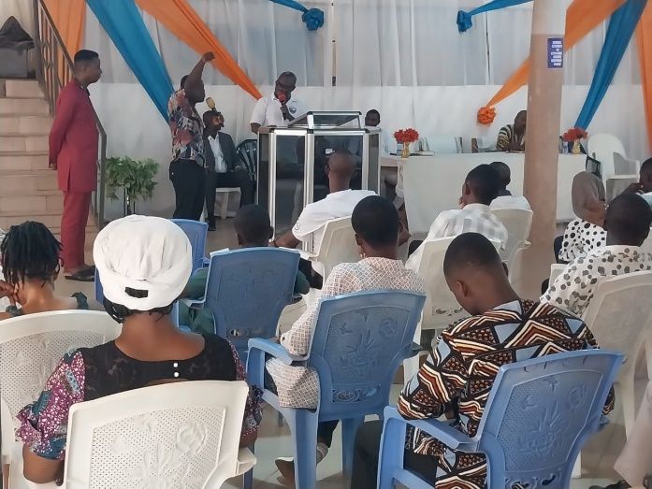
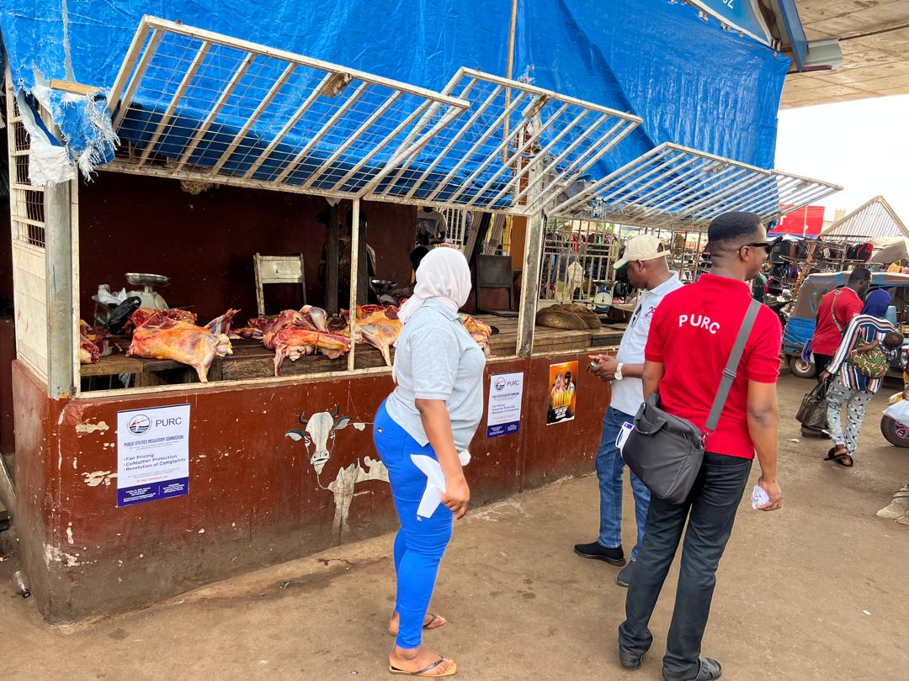
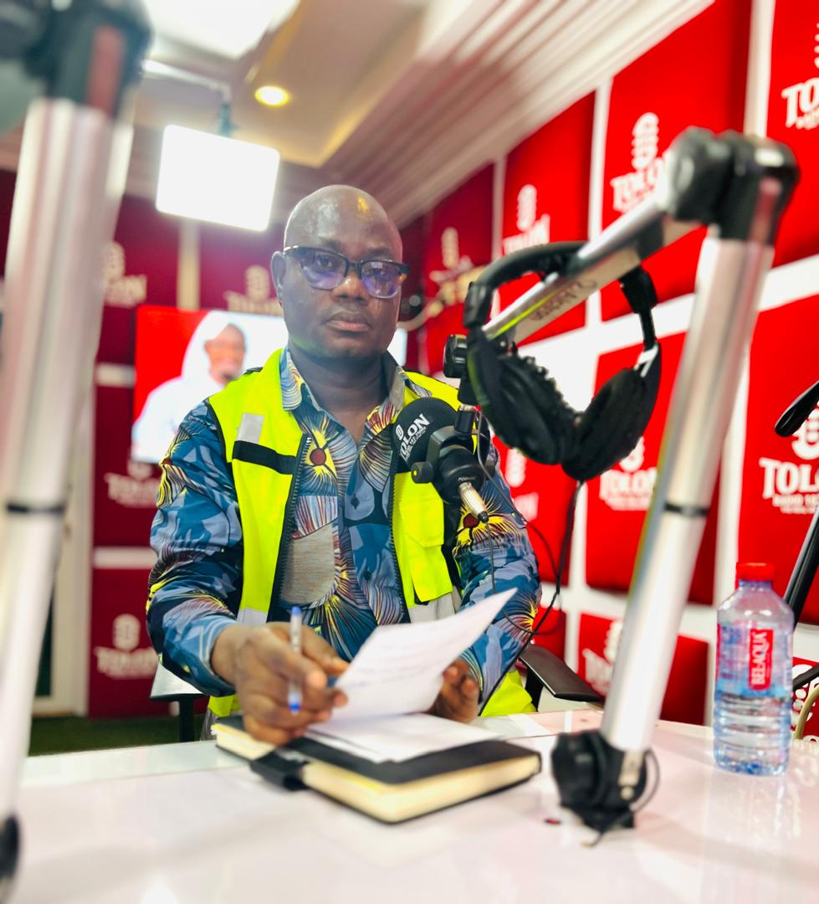
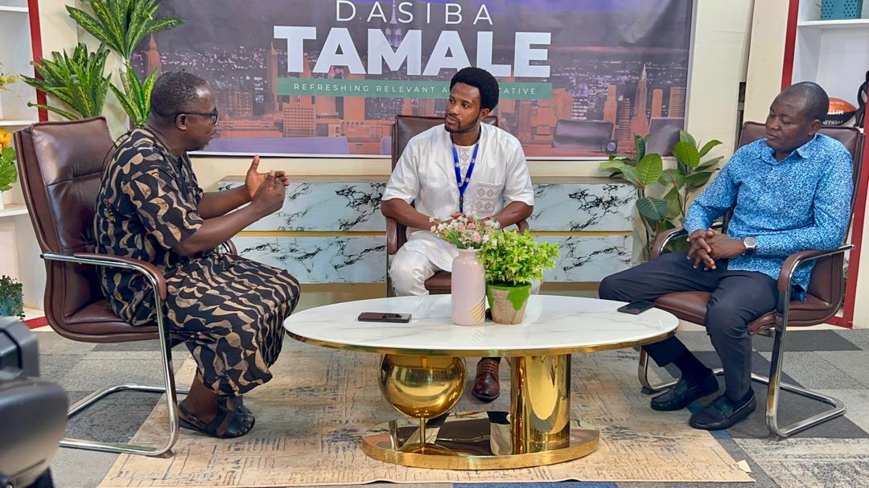
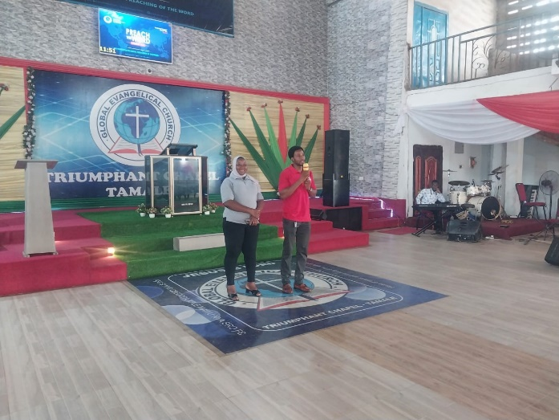
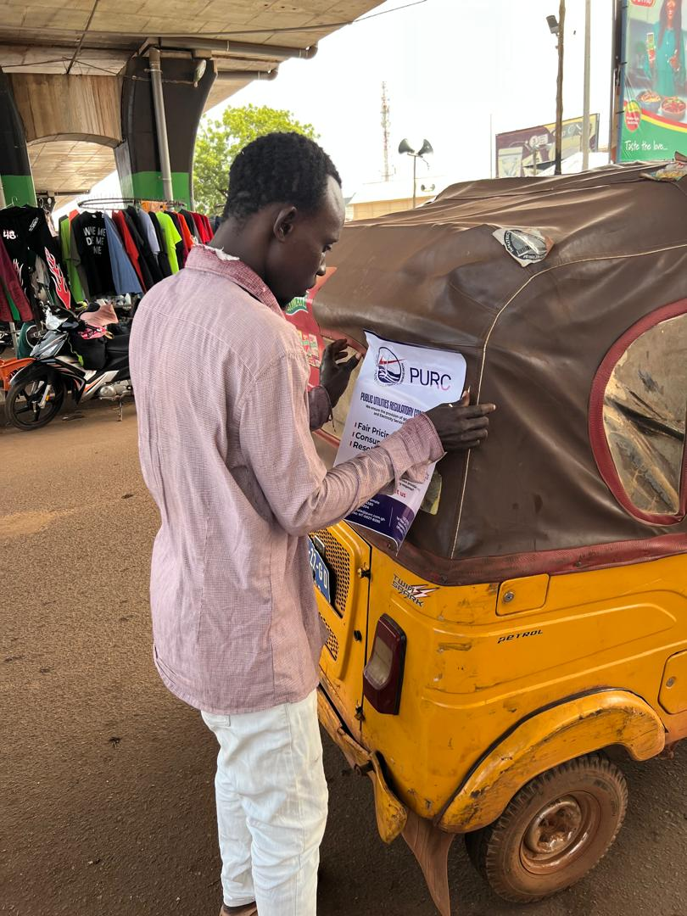
Public Education

Slide 17
Regulatory Impacts (Adjustment & Recoveries)
¢
ADJ & REC
¢
¢
GH¢68,266.64
¢
GH¢125,307.58
Facilitated for twelve (12) customers of NEDCo with billing issues
Facilitated revenue recovery for GWL from eighteen (18) customers
¢
¢
¢
¢
GH¢2017.23
GH¢2980.85
Facilitated revenue recovery from one (1) customer in favor of NEDCo
Facilitated in favor of four(4) customers of GWL
The Regional office of PURC for the reporting period facilitated adjustments and revenue recoveries for both customers and service providers totalling GH¢70,283.87 and GH¢127,324.81 respectively

Slide 18
Regulatory Impacts
Facilitated the injection, repair and replacement of six(6) transformers within the period under review.
Facilitated the replacement of twenty (21) broken poles, twelve (12) High tension and nine(9) low voltage poles.

Slide 19
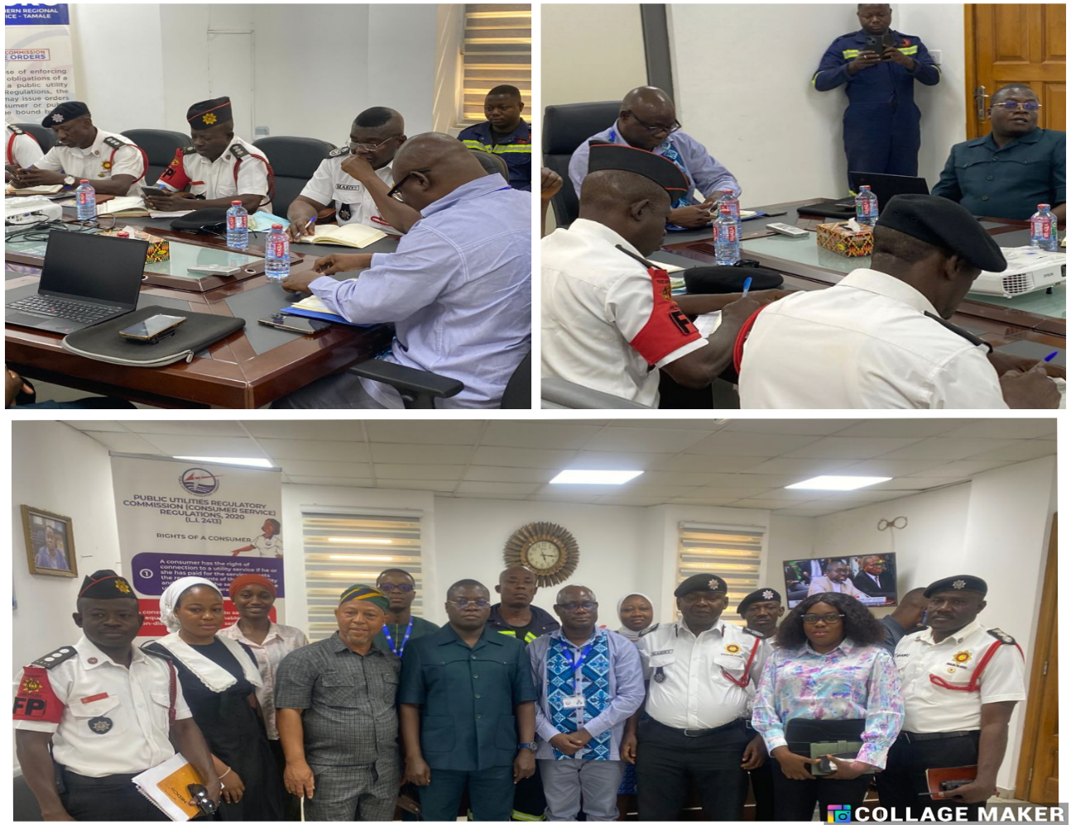
Regulatory Interventions
The Regional office addressed an impasse between Ghana Water Limited and Ghana National Fire Service(GNFS) over GNFS’s contribution to high Non-Revenue Water.

Slide 20
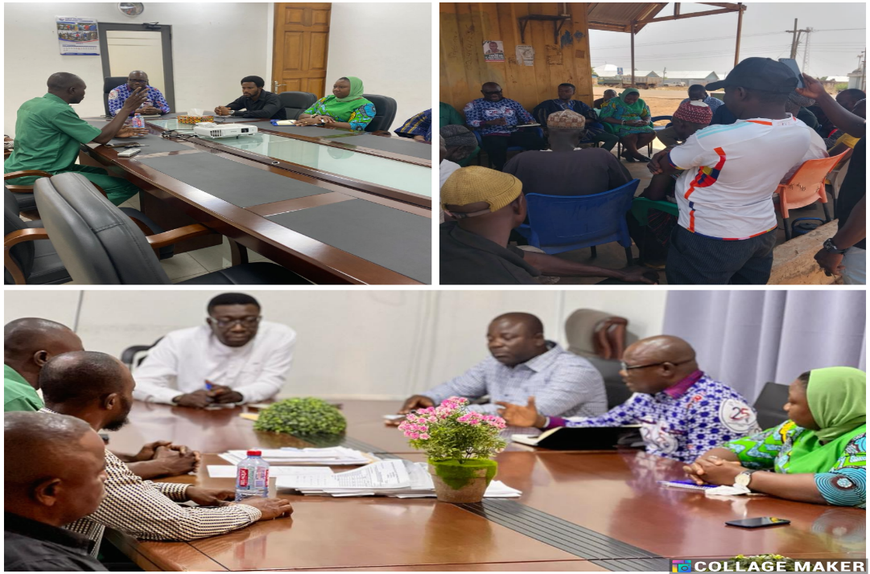
Regulatory Interventions
The Regional office also intervened timely in the re-connection of Sanzerigu, a community in Tamale after a community member had interfered with the LV network.

Slide 21
Special Initiatives
The Northern Regional office for the period under review, initiated activities aimed at deepening awareness of the commission, ensuring speedy resolution to consumer concerns or complaints, improving revenue collection and reducing illegal connection activities for the service providers in programs dubbed:
PURC @ A GLANCE and REGULATION @ A GLANCE
Weekend Complaint Resolution Booth
Tamale In Focus Project
Regulatory Dialogue

Slide 22

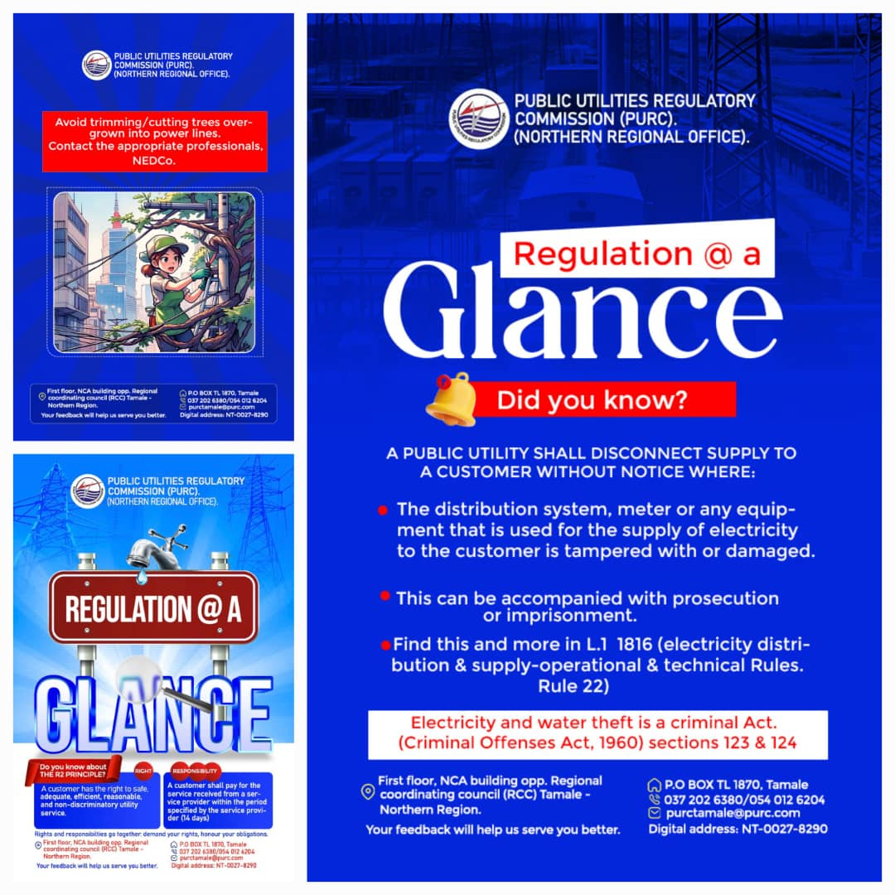
Special Initiatives
PURC @ A GLANCE and REGULATION @ A GLANCE
This is aimed at deepening awareness about the Commission and the regulatory framework. Various stakeholders and the consuming public are educated on pertinent issues relating to utility services through flyers and videos,virtually and in-person.

Slide 23
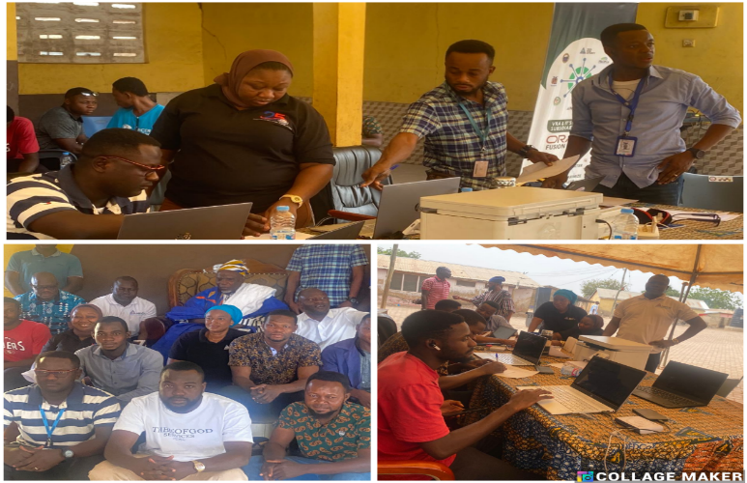
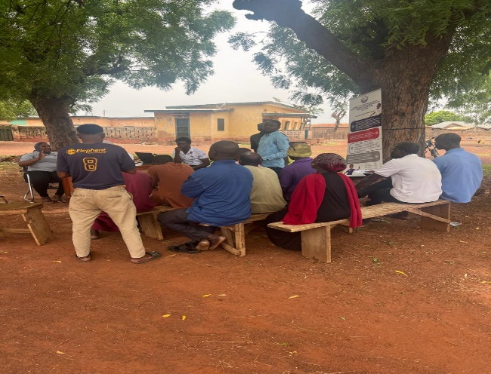
Special Initiatives
Weekend Complaint Resolution Booth
This is aimed at ensuring prompt resolution to consumer complaints and involves the regulator and service provider. So far more than fifty(50) customers have benefitted from this program through facilitation of payment schedules, meter replacement, correction of billing anomalies, etc within Tamale and Savelugu.

Slide 24
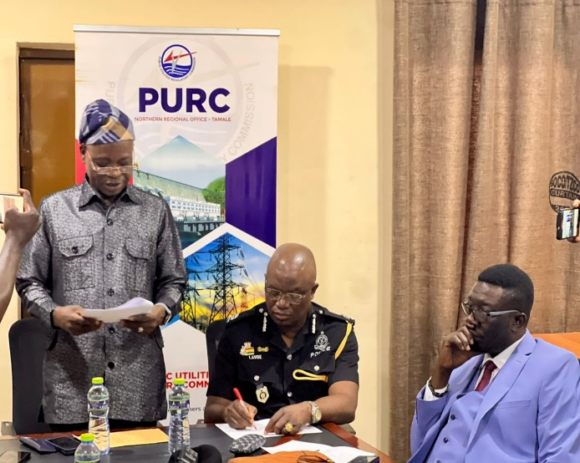
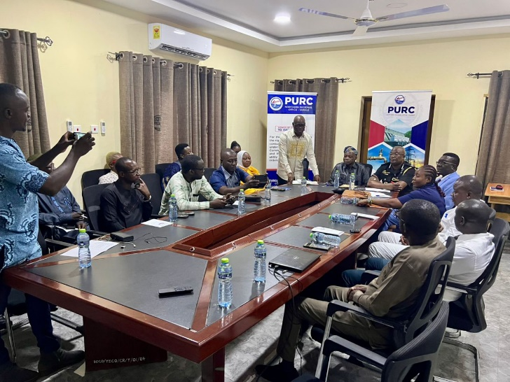
Special Initiatives
Tamale In Focus Project
The focus of this project is to assist in the reduction of the commercial losses of the utility service providers, improve on their revenue collection, minimize the activities of illegal connections and to improve on service quality and reliability in the Greater Tamale through engagement, education and enforcement.

Slide 25
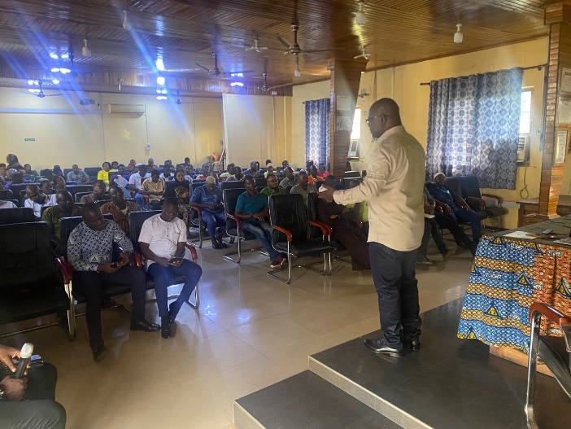
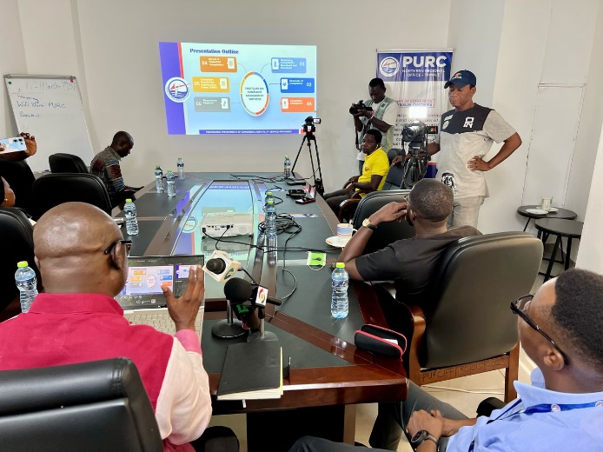
Special Initiatives
Regulatory Dialogue
This initiative involves engagement with key stakeholders on some key portions of the L.I. 2413.The Regional Office has so far engaged the Loss Control team of GWL, NEDCo staff and the media. The platform offered the opportunity to expose NEDCo and GWL to disconnection and the position of the law and a media collation about PURC’s quarterly tariff review.

Slide 26
Conclusion and Way Forward
Collaboration between the Commission and NEDCo has brought about the payment of a full year weekend radio education program costing around GH48,000 as well as sponsorship for other programs such as the Tamale in Focus project.
The service provider has taken pragmatic steps in meeting the Commission’s benchmarks as far as service reliability is concerned, however network interferences and commercial losses continues to be a challenge
The Commission intends to deepen its stakeholder engagement in the fight against illegal connection in the coming quarter.
Capacity building programs for various stakeholders would be embarked by the Regional office in the coming quarter

Slide 27
Thank you

