Slide 1

REPORT ON INVESTIGATION INTO THE UNTIMELY DEATH OF CHARLES AMISSAH DUE TO THE DENIAL OF EMERGENCY CARE AT THE POLICE HOSPITAL, GARH & KBTH ON 6TH FEBRUARY, 2026
SUBMITTED TO
HON. MINISTER FOR HEALTH
KWABENA MINTAH AKANDOH (MP)
UNDER COMMITTEE CHAIRMANSHIP OF
PROF. AGYEMAN BADU AKOSA
6TH MAY, 2026

Slide 2
INTRODUCTION

Slide 3
Brief background
On 6th February, 2026 media publications on untimely death of Charles Amissah who was involved in a motor cycle accident at Circle Overhead Bridge.
Reports of denial of emergency care to Charles Amissah at Police Hospital, Greater Accra Regional Hospital (GARH) & Korle Bu Teaching Hospital (KBTH).
On 23rd February, 2026 Hon. Minister for Health, Kwabena Mintah Akandoh (MP), constituted an Investigation Committee to carry out comprehensive inquiry into death of Charles Amissah.

Slide 4
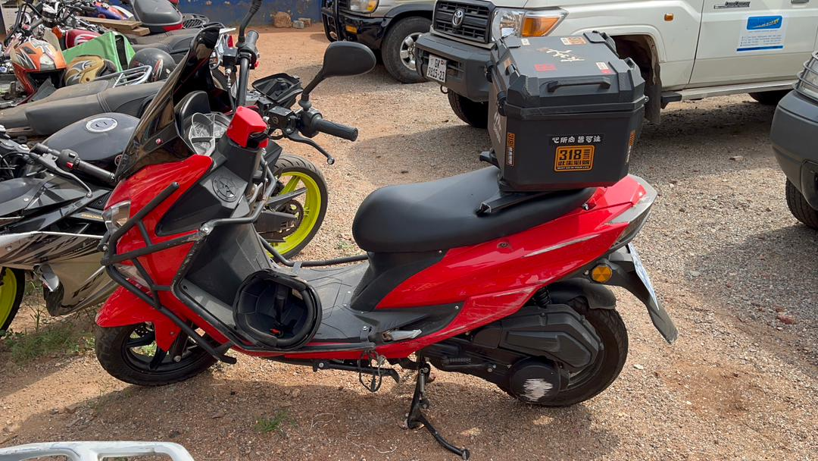
Motor cycle of Charles Amissah

Slide 5
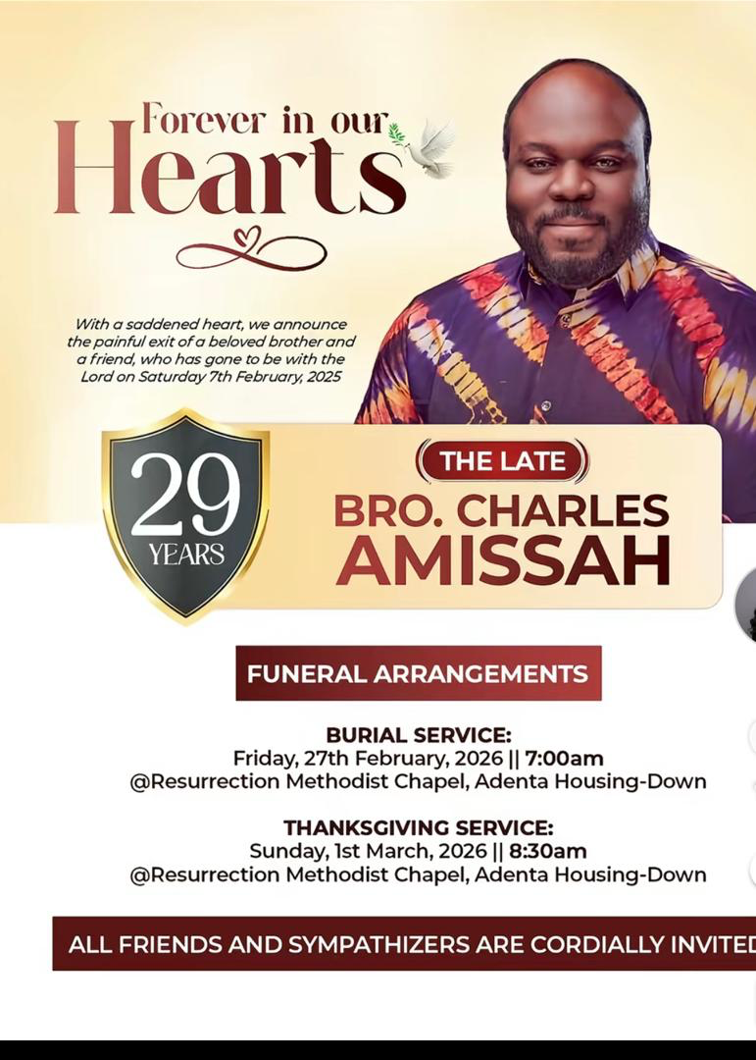
Charles Amissah

Slide 6
Composition of Cttee
Name | Representation | Position
Prof. Agyeman Badu Akosa | Retired Consultant Pathologist & Former DG of GHS | Chairman
Dr.(Med) Koku Awoonor-Williams | Technical Advisor, MoH & Consultant, WHO | Member
Dr.(Med) Conrad Buckle | Consultant, Emergency Medicine (UK & Ghana) | Member
Dr.(Med) Henry K. Bulley | Snr Emergency Medicine Physician & Head, Department of A&E, KBTH | Member
Dr.(Med) Kwame Ekremet | Snr Emergency Medicine Physician, Head, Emergency Department, UGMC | Member
Madam Faustina Excel Adipa | Emergency & Critical Care Nurse & Principal, Peri-Operative & Critical Care Nursing School | Member
Madam Gertrude Nana Konadu Agyeman | Emergency & Critical Care Nurse & Rep of GRNMA | Member
Alhaji Dr.(Pharm) Inua I. Yusuf, Esq. | Head/Dir., Legal Affairs, MoH & Snr. Specialist Pharmacist, GHS & Lawyer | Member/ Secretary
Mr. Da-Costa Osei Agyekum | Snr. Administrative Manager, MoH | Member/ Recorder

Slide 7
Objectives
To conduct a comprehensive & independent investigation into circumstances leading to the death of Charles Amissah.
To conduct a comprehensive & independent investigation into circumstances leading to alleged denial of emergency care to Charles Amissah at the Police Hospital, GARH & KBTH.

Slide 8
POLICY & LEGAL PERSPECTIVES

Slide 9
Policy perspectives of emergency care
Some national level policies reviewed:
National Health Policy.
Human Resource Management Policy Framework & Manual for the Ghana Public Services.
MoH Accident & Emergency Services & Guidelines.

Slide 10
Legal perspectives of emergency care
Some legislative provisions reviewed:
1992 Constitution
Health Facilities Regulatory Agency
Patient’s Charter
Health Professions Regulatory Bodies
Professional Bodies Registration
National Ambulance Service
National Blood Service
Health Insurance
Health Financing

Slide 11
MEDICAL INTERVENTION IN EMERGENCIES

Slide 12
Basic life-saving technique
The ATLS 11th Edition (2026) – xABCDE Algorithm:
x: Control of exsanguinating external haemorrage.
A: Airway maintenance with cervical spine motion restriction.
B: Breathing & ventilation.
C: Circulation, hemorrhage control & management of shock.
D: Disability.
E: Exposure & environmental control.

Slide 13
APPROACH TO INQUIRY

Slide 14
Sites Visited to ascertain events & emergency care flow:
Accident site.
Circle Overhead Ambulance Bay.
Police Hospital.
Greater Accra Regional Hospital (GARH).
Korle Bu Teaching Hospital (KBTH).
Ghana Armed Forces Critical Care & Emergency Hospital (GAFCCEH).
37 Military Hospital.

Slide 15
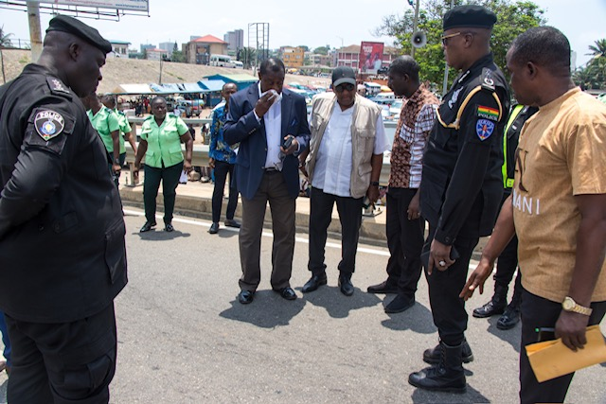
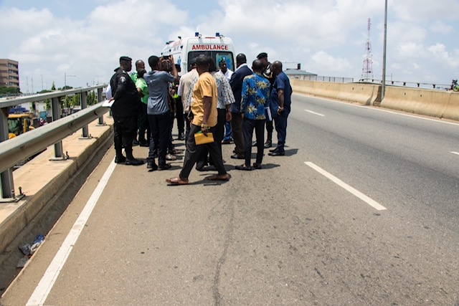
Sites visited – 1
Circle Overhead
Circle Overhead

Slide 16
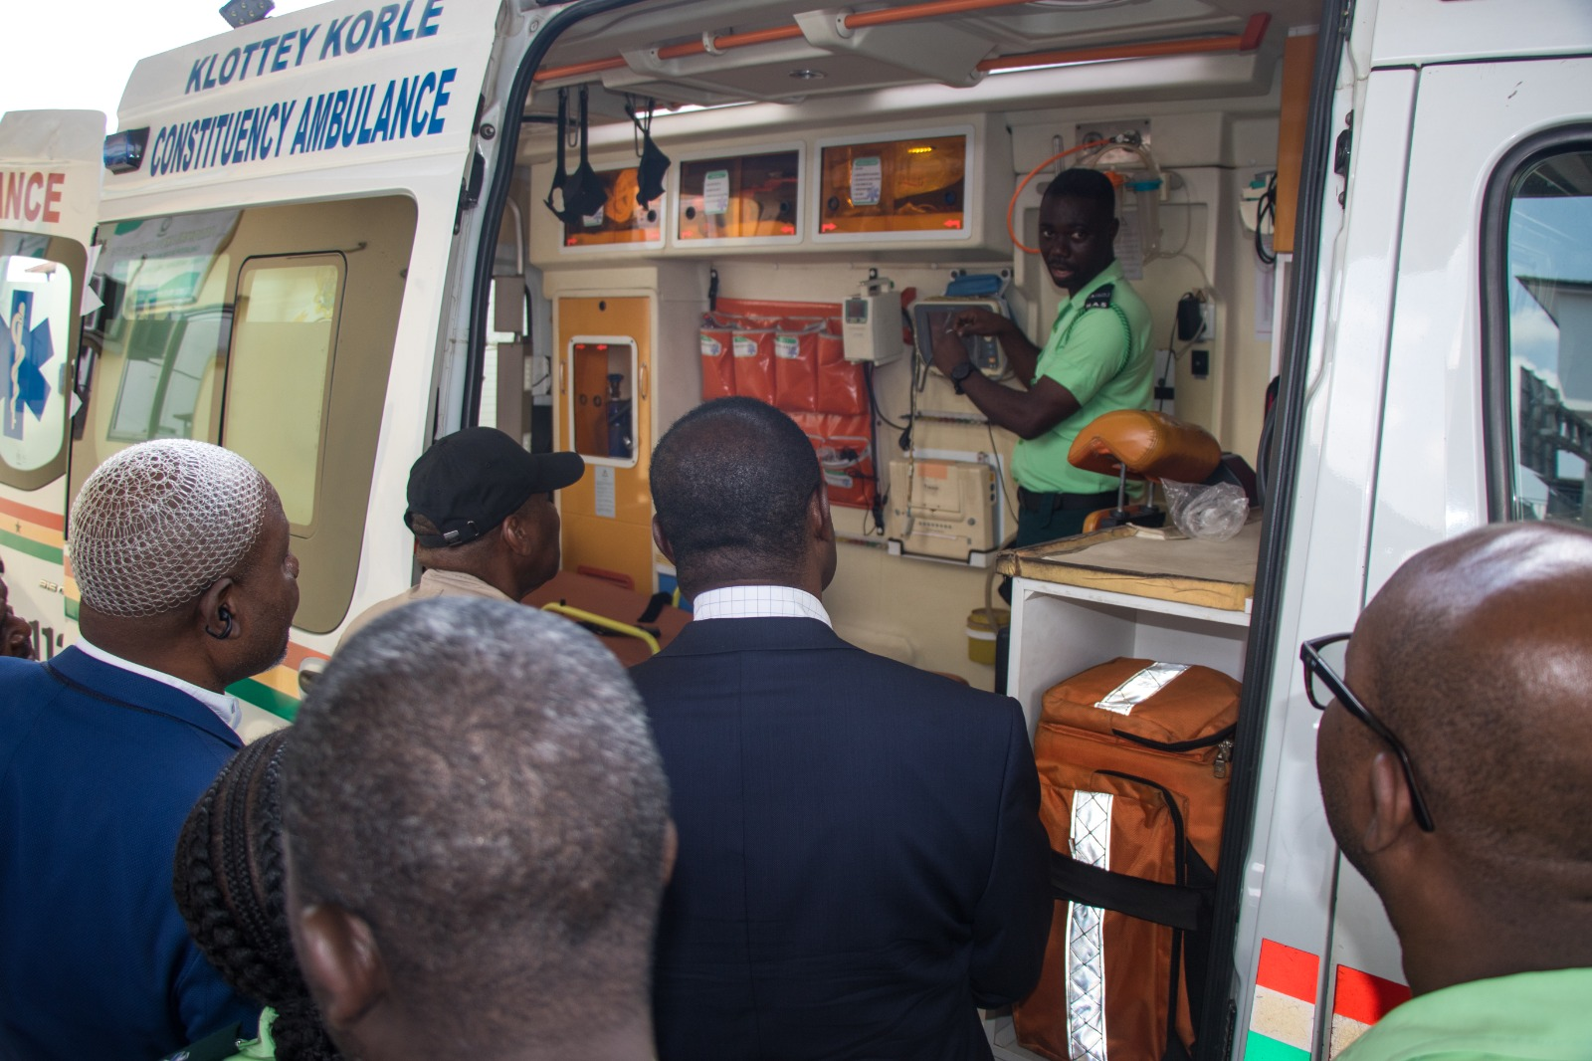
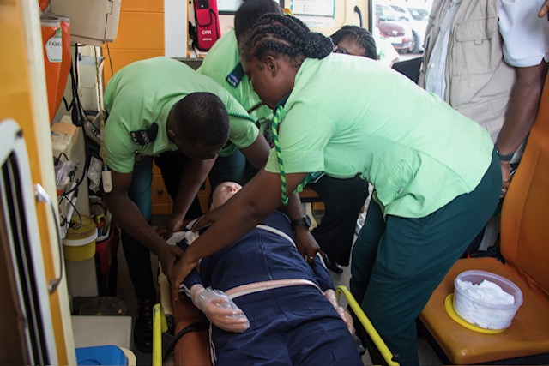
Sites visited – 2
Ambulance Station @ Circle
Ambulance Station @ Circle

Slide 17
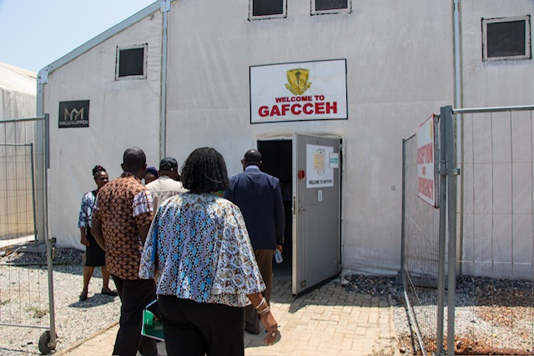
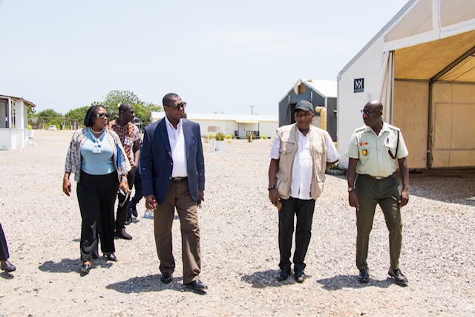
Sites visited – 3
GAFCCEH
GAFCCEH

Slide 18
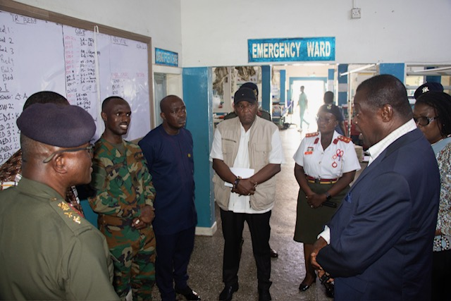
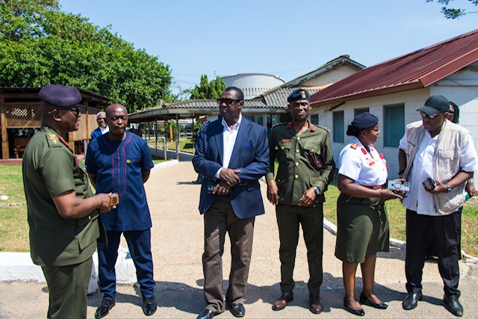
Sites visited – 4
37 Military Hospital A&E Dept
37 Military Hospital

Slide 19
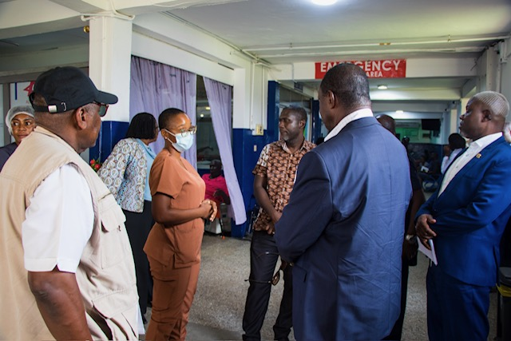
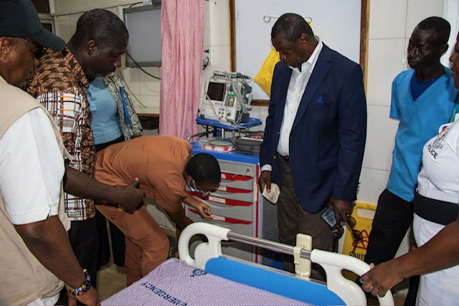
Sites visited – 5
Police Hospital A&E Dept
Police Hospital A&E Dept

Slide 20
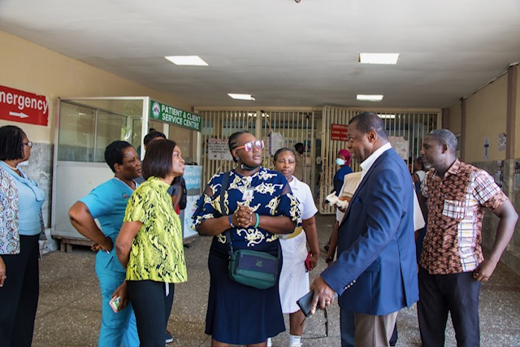
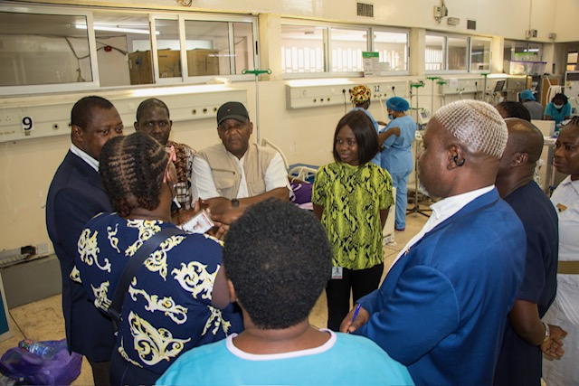
Sites visited – 6
KBTH A&E Dept
KBTH A&E Dept

Slide 21
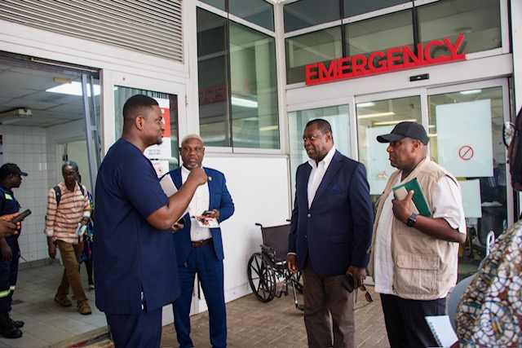
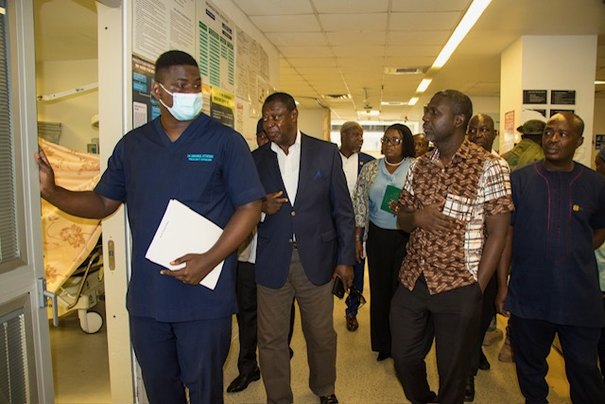
Sites visited – 7
Ridge Hospital A&E Dept
Ridge Hospital A&E Dept

Slide 22
Inquiry meetings with staff of NAS, Police Hospital, GARH & KBTH
Ambulance crew - EMTs
Dr.(Med) Anne-Marie Kudowor - MO – Police Hospital
Dr.(Med) Nina Naomi Eyram Adotevi - SMO – GARH
Miss Akosua B. Turkson - Triage Nurse – GARH
Dr.(Med) Ida Druant - ES – KBTH
Dr.(Med) Genevieve Adjar - ED – KBTH
Miss Joy Daisy Nelson - Staff Triage Nurse – KBTH
Miss Salamatu Alhassan Aidoo - Staff Triage Nurse – KBTH
Dr.(Med) Kwasi Sobre Nkrumah - MO – KBTH
Dr.(Med) Blankson Aboagye - Pathologist – KBTH

Slide 23
Consultative Meetings Held
Public institutions
National Ambulance Service (NAS)
Police Hospital
Greater Accra Regional Hospital (GARH)
Korle Bu Teaching Hospital (KBTH)
Health Facilities Regulatory Agency (HeFRA)
St. John Ambulance Service
Medical & Dental Council (MDC)
Ghana Police Motor Traffic & Transport Directorate (MTTD)
National Pensions Regulatory Authority (NPRA)

Slide 24
Public institutions (Cont’d)
Social Security & National Insurance Trust (SSNIT)
National Insurance Commission (NIC)
Ghana Health Service (GHS)
Health Promotion Divisions (HPD) of GHS
Nursing & Midwifery Council (NMC)
Ghana College of Physicians & Surgeons (GCPS)
Faculty of Emergency Medicine (FEM) of GCPS
National Blood Service (NBS)
Christian Health Association of Ghana (CHAG)

Slide 25
Professional bodies:
Ghana Medical Association (GMA)
Ghana Registered Nurses & Midwives Association (GRNMA)
Ghana Physician Assistants Association (GPAA)
Ghana Association of Quasi-Government Institutions (GHAGQI)
Society of Private Medical & Dental Practitioners (SPMDP)
Ghana Journalists Association (GJA)
Emergency Medical Technician Association of Ghana (EMTAG)
Health & Development Consortium (HDC)

Slide 26
Feedback from family & general public – 1
Meeting with family of Charles Amissah.
Consultative feedback from organisations (3):
Emergency Medicine Society of Ghana (EMSOG)
Emergency Medicine Residents: Accra
Retired Nurses & Midwives Club

Slide 27
Consultative feedback from 17 individuals:
Alberta Amponsah
Anthonia Agbotse
Collins Owusu
Dr. Joseph Apeadido
Dr. Selorm Kwashie
Dr. George Amofah
Elvis Kwadwo Alabili
Emmanuela Asante
Hannah Adjei-Mensah

Slide 28
Consultative feedback from 17 individuals (cont.)
Heike Drechsel-Atta
Jonathan Moagbanja
Kwadzo Gadese
Maame Akuamoah Yeboah
Wissih Kudji
Francis Odei-Ansong
Dr.(Med) Joseph Oliver-Commey
Veronica Addo Donkor

Slide 29
POST MORTEM REPORT

Slide 30
Significant post mortem findings:
Deep laceration injury of right upper arm blood vessels & muscles.
Comminuted open fracture of right upper humerus.
Severe pallor of all internal organs.
Shocked kidneys from exsanguination.
Cerebral oedema.
Mild cardiomegaly.

Slide 31
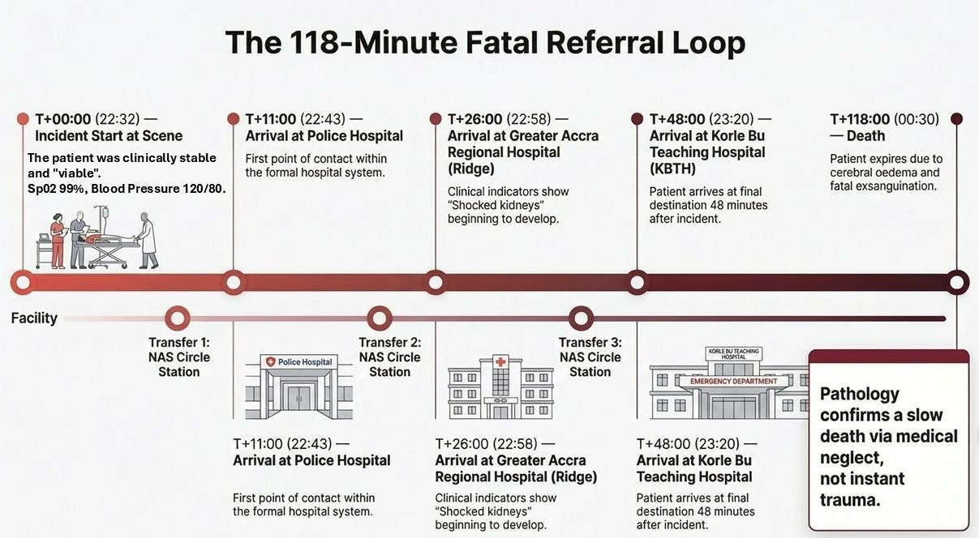

Slide 32
KEY FINDINGS

Slide 33
Key findings – 1
Charles Amissah died of:
Exsanguination (excessive loss of blood) due to right upper arm bone & soft tissue injuries, causing damage to axillary & brachial arteries & veins, following a road traffic accident.

Slide 34
Key findings – 2
Death of Charles Amissah could have been avoided by:
Medical intervention at the Police Hospital, GARH or KBTH.
Application of compression on the laceration & packing of deeper wound during transportation in ambulance.
Administration of intravenous fluids in ambulance during transportation.
Administration of intravenous fluids & whole blood at Police Hospital, GARH or KBTH.

Slide 35
Key findings – 3
Key findings related to the NAS:
Lack of documentation of critical vital signs of the patient.
Lack of formal handing over procedures.
Lack of proper chain of command interaction.
Tube of BP apparatus cuff in ambulance too short for continuous monitoring of the patient’s BP.

Slide 36
Key findings – 4
Key findings related to the Police Hospital:
Ambulance arrived at hospital with the patient alive.
Hospital failed to triage the patient & initiate stabilizing interventions.
Ambulance moved with the patient out of hospital after about 11 minutes.

Slide 37
Key findings – 5
Key findings related to the GARH:
Ambulance arrived at hospital with the patient alive.
Hospital failed to triage the patient & initiate stabilizing interventions.
Ambulance moved with the patient out of hospital after about 17 minutes.

Slide 38
Key findings – 6
Key findings related to the KBTH:
Ambulance arrived at hospital with the patient alive.
Hospital failed to triage the patient & initiate stabilizing interventions.
Ambulance crew was redirected by KBTH to UGMC.
The patient died in the ambulance in about 70 minutes while in hospital.

Slide 39
Key findings – 7
Key findings in respect of the ambulance crew:
Inconsistency in the taking & reporting of vital signs of the patient.
Lack of basic life support (BLS), advanced cardiac life support (ACLS) & advanced trauma life support (ATLS) skills.

Slide 40
Key findings – 8
Key findings in respect of professionals (1):
Dr.(Med) Anne-Marie Kudowor failed to exercise ethical & professional judgment prudently by not attending to Charles Amissah in a life-threatening condition at Police Hospital, leading to his death later from severe loss of blood; & was untruthful to the Committee.

Slide 41
Key findings – 9
Key findings in respect of professionals (2):
Dr.(Med) Nina Naomi Eyram Adotevi failed to exercise ethical & professional judgment prudently by not attending to Charles Amissah in a life-threatening condition at GARH, leading to his death later from severe loss of blood.

Slide 42
Key findings – 10
Key findings in respect of professionals (3):
Dr.(Med) Ida Druant failed to exercise ethical & professional judgment prudently by not attending to Charles Amissah in a life-threatening condition at KBTH, leading to his death later from severe loss of blood.

Slide 43
Key findings – 11
Key findings in respect of professionals (4):
Dr.(Med) Genevieve Adjar failed to exercise ethical & professional judgment prudently by not attending to Charles Amissah in a life-threatening condition at KBTH, leading to his death later from severe loss of blood.

Slide 44
Key findings – 12
Key findings in respect of professionals (5):
Miss Akosua B. Turkson failed to exercise ethical & professional judgment prudently by not attending to Charles Amissah in a life-threatening condition at GARH, leading to his death later from severe loss of blood.

Slide 45
Key findings – 13
Key findings in respect of professionals (6):
Miss Joy Daisy Nelson failed to exercise ethical & professional judgment prudently by not attending to Charles Amissah in a life-threatening condition at KBTH, leading to his death later from severe loss of blood.

Slide 46
Key findings – 14
Key findings in respect of professionals (7):
Miss Salamatu Alhassan Aidoo failed to exercise ethical & professional judgment prudently by not attending to Charles Amissah in a life-threatening condition at KBTH, leading to his death later from severe loss of blood.

Slide 47
CONCLUSION

Slide 48
Conclusion
The medical staff on duty at the Police hospital, GARH & KBTH failed to attend to Charles Amissah when he was in a life-threatening condition, and this led to his avoidable death.

Slide 49
SPECIFIC RECOMMENDATIONS

Slide 50
Specific recommendation – 1
Dr.(Med) Anne-Marie Kudowor should be referred to Police Hospital & MDC for disciplinary action against her for breach of professional duty to Charles Amissah; & for being untruthful to the Committee.

Slide 51
Specific recommendation – 2
Dr.(Med) Nina Naomi Eyram Adotevi should be referred to GARH & MDC for disciplinary action against her for breach of professional duty to Charles Amissah.

Slide 52
Specific recommendation – 3
Dr.(Med) Ida Druant should be referred to KBTH & MDC for disciplinary action against her for breach of professional duty to Charles Amissah.

Slide 53
Specific recommendation – 4
Dr.(Med) Genevieve Adjar should be referred to KBTH & MDC for disciplinary action against her for breach of professional duty to Charles Amissah.

Slide 54
Specific recommendation – 5
Miss Akosua B. Turkson should be referred to GARH & NMC for disciplinary action against her for breach of professional duty to Charles Amissah.

Slide 55
Specific recommendation – 6
Miss Joy Daisy Nelson should be referred to KBTH & NMC for disciplinary action against her for breach of professional duty to Charles Amissah.

Slide 56
Specific recommendation – 7
Miss Salamatu Alhassan Aidoo should be referred to KBTH & NMC for disciplinary action against her for breach of professional duty to Charles Amissah.

Slide 57
Specific recommendation – 8
Expedite action on the establishment of a National Electronic Emergency Bed Management System (NEEBMS).

Slide 58
Specific recommendation – 9
Take steps to fully integrate the Ghana Armed Forces Critical Care & Emergency Hospital (GAFCCEH) into the national emergency and critical care system.

Slide 59
Specific recommendation – 10
Ensure compulsory triaging of all patients brought to healthcare facilities in a state of emergency across the country .

Slide 60
Specific recommendation – 11
Establish a National Emergency Care Fund (NECF) to enable emergency care for the first 24 hours in public & private healthcare facilities across the country.

Slide 61
Specific recommendation – 12
Expedite action on legislation for public & private healthcare facilities to prioritize life-threatening cases & ensure stabilizing interventions for patients in need of emergency care across the country.

Slide 62
Specific recommendation – 13
Ensure basic life support (BLS) & advanced cardiac life support (ACLS) training for health workers, pupils, students & general public.

Slide 63
Specific recommendation – 14
Establish a national governance & management system for emergency care to ensure implementation of all game-changing interventions in public & private healthcare facilities across the country.

Slide 64
The Committee wishes to express our profound gratitude to the Hon. Minister for Health, Kwabena Mintah Akandoh (MP), for the trust & confidence reposed in us for this honorous assignment. THANK YOU.

